Slide 1
Detecting Sleep Apnea – Projet Period 2
Resampling Annotations
Some results after resampling

Slide 2
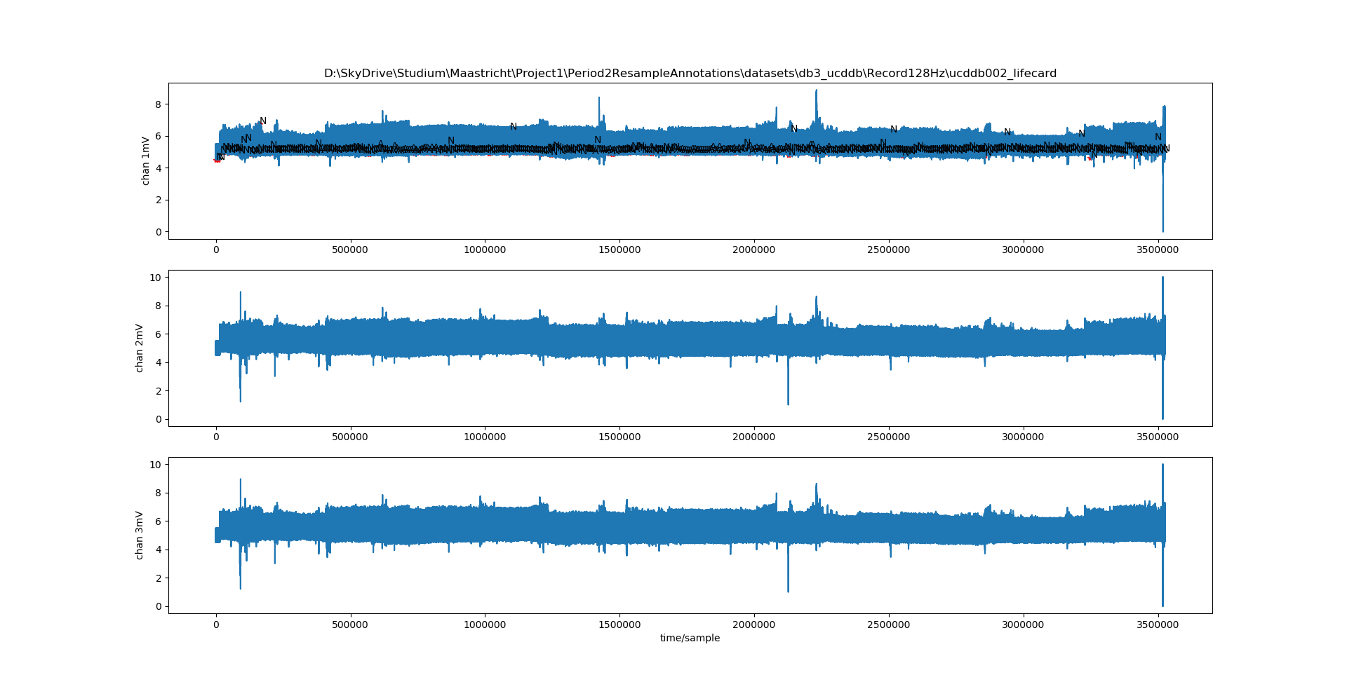
Database 2: ucddb002 128Hz original (+ resampled ann.)

Slide 3
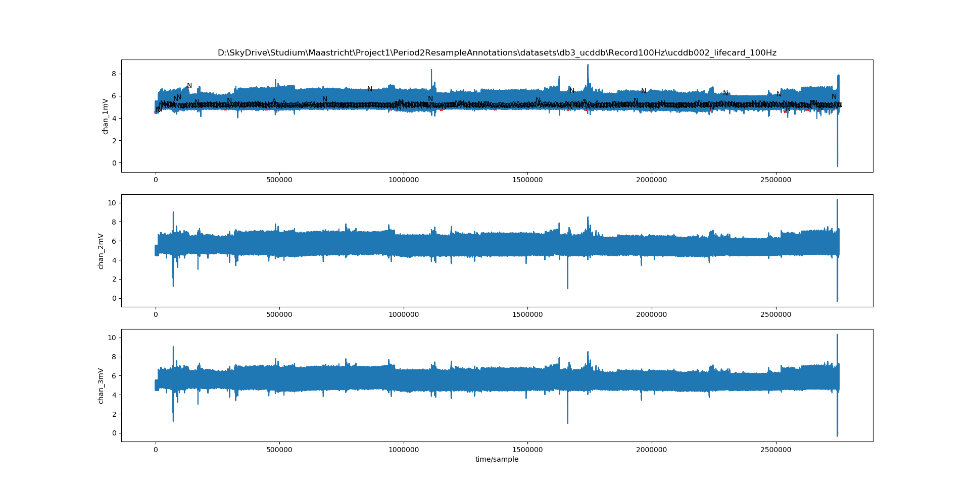
Database 2: ucddb002 100Hz (+ resampled ann.)

Slide 4
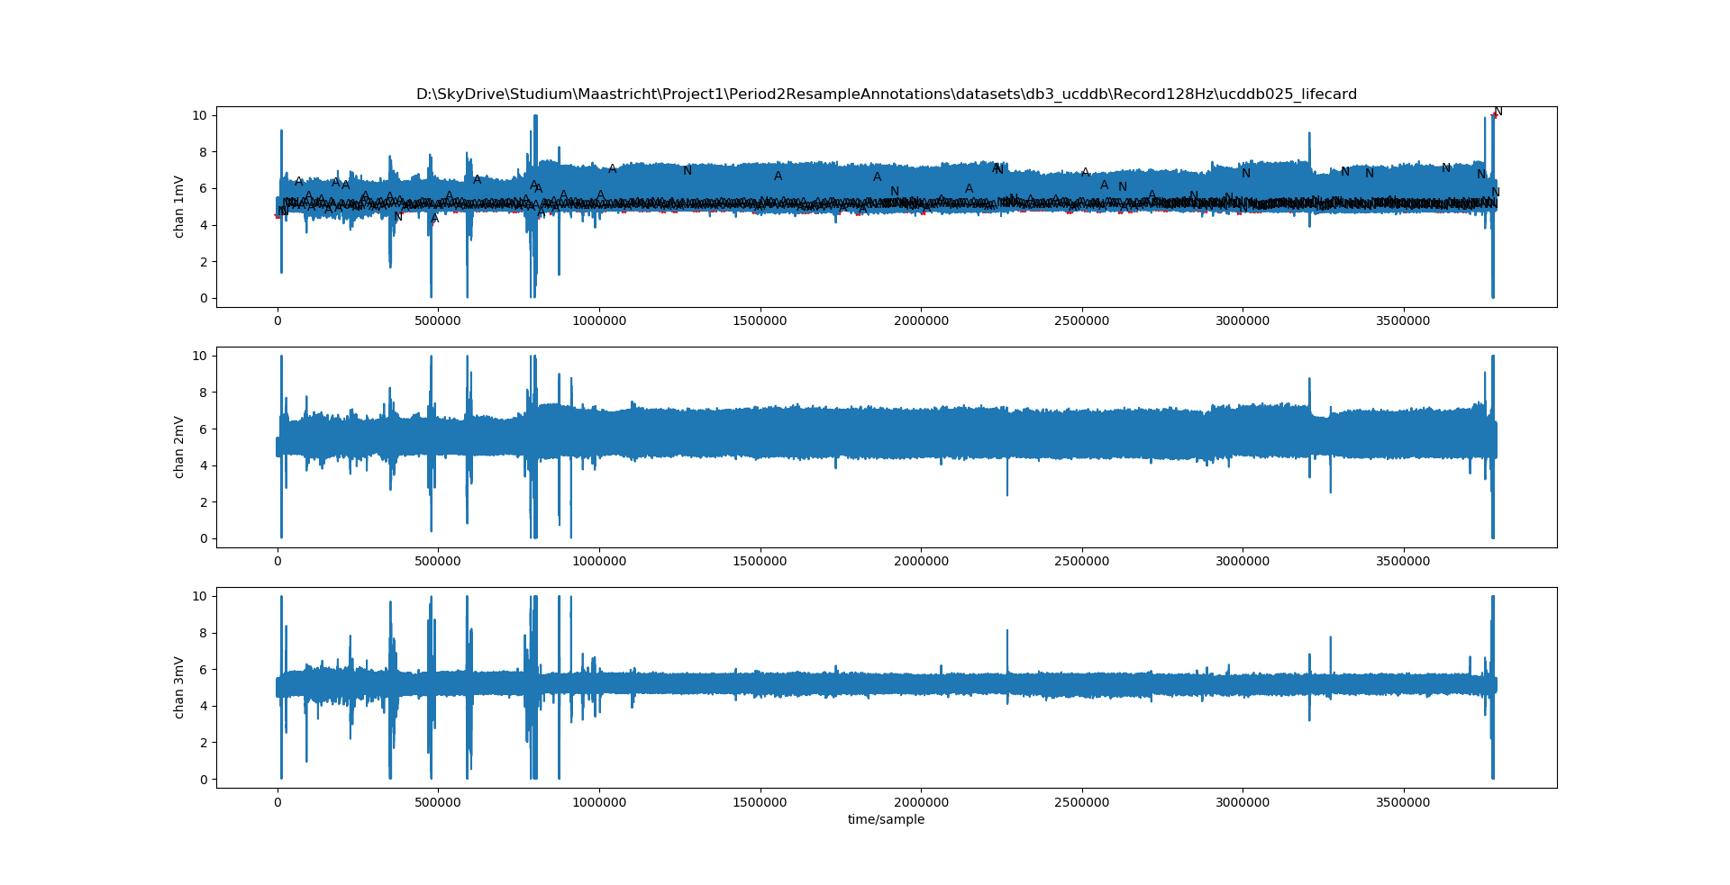
Database 2: ucddb025 128Hz original (+ resampled ann.)

Slide 5
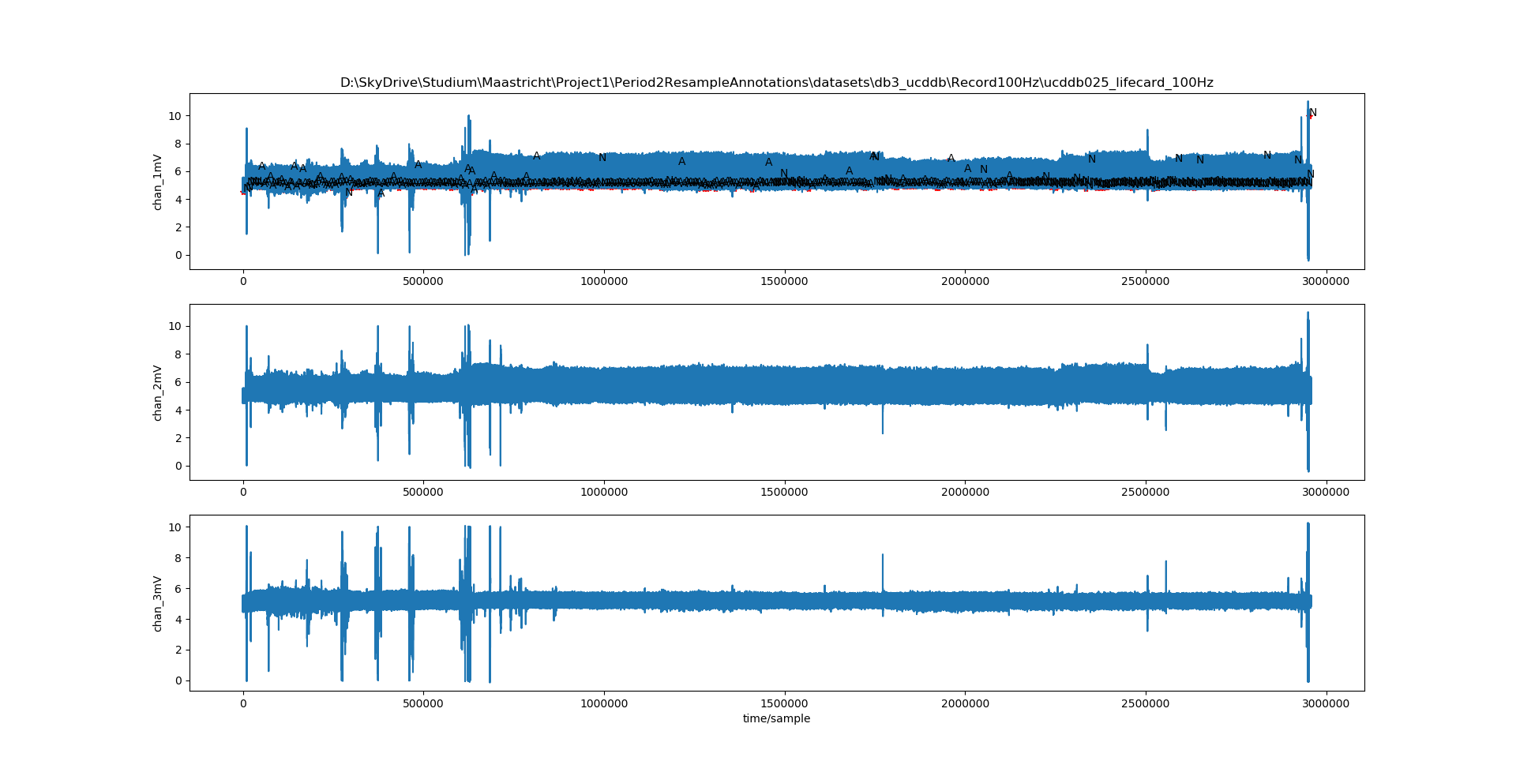
Database 2: ucddb025 100Hz (+ resampled ann.)

Slide 6
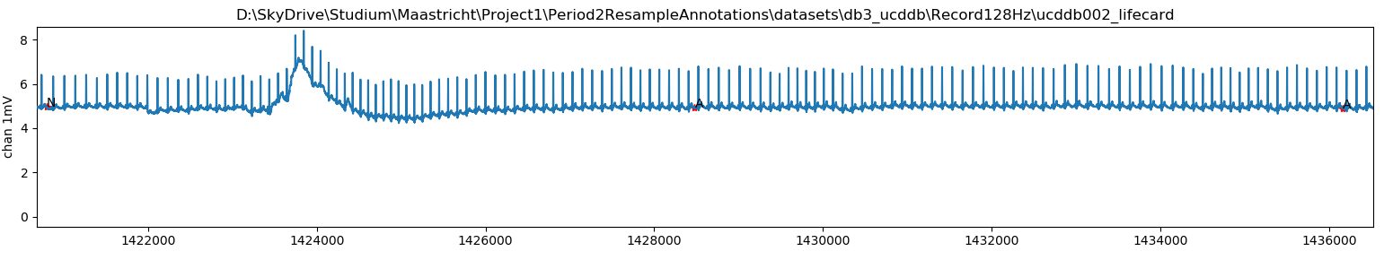
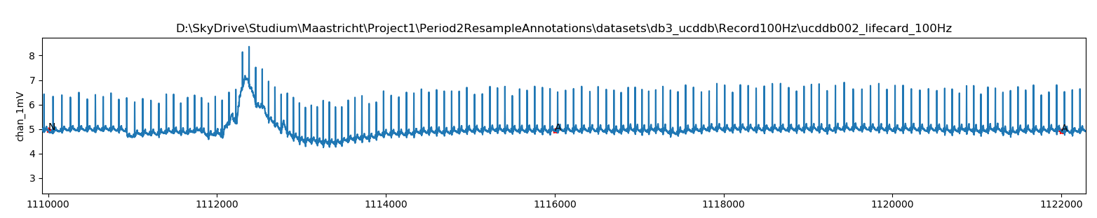

Slide 7
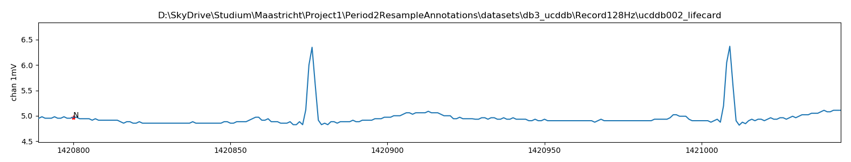
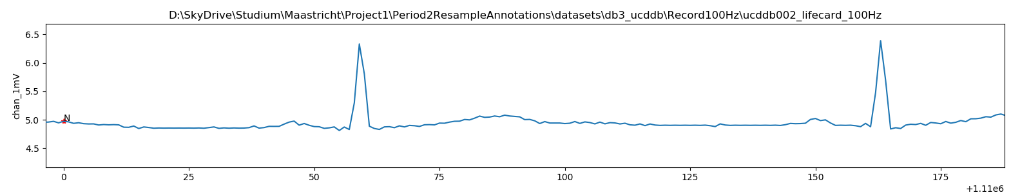

Slide 8
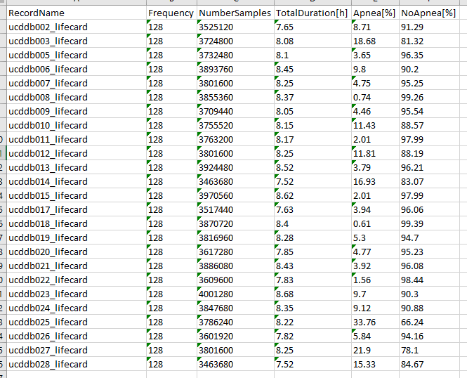
Database 2: 128Hz - all data sets info

Slide 9
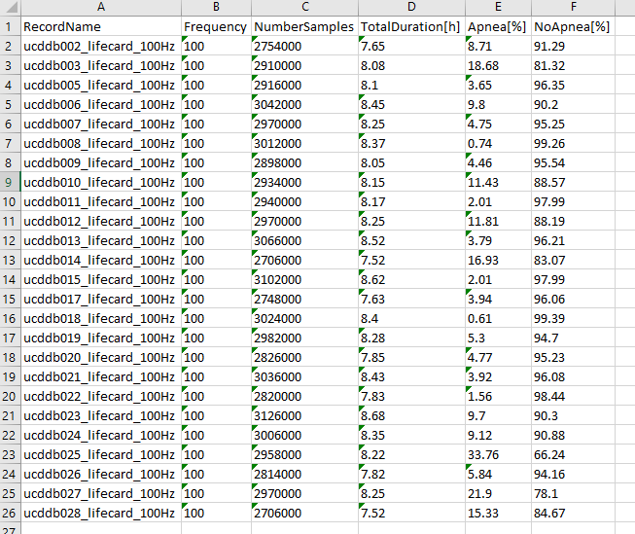
Database 2: 100Hz - all data sets info

